Slide 1
NoSQL Databases / MongoDB.

Slide 2
What is NoSQL
NoSQL Database is used to refer a non-SQL or non relational database.
It provides a mechanism for storage and retrieval of data other than tabular relations model used in relational databases. NoSQL database doesn't use tables for storing data. It is generally used to store big data and real-time web applications.

Slide 3
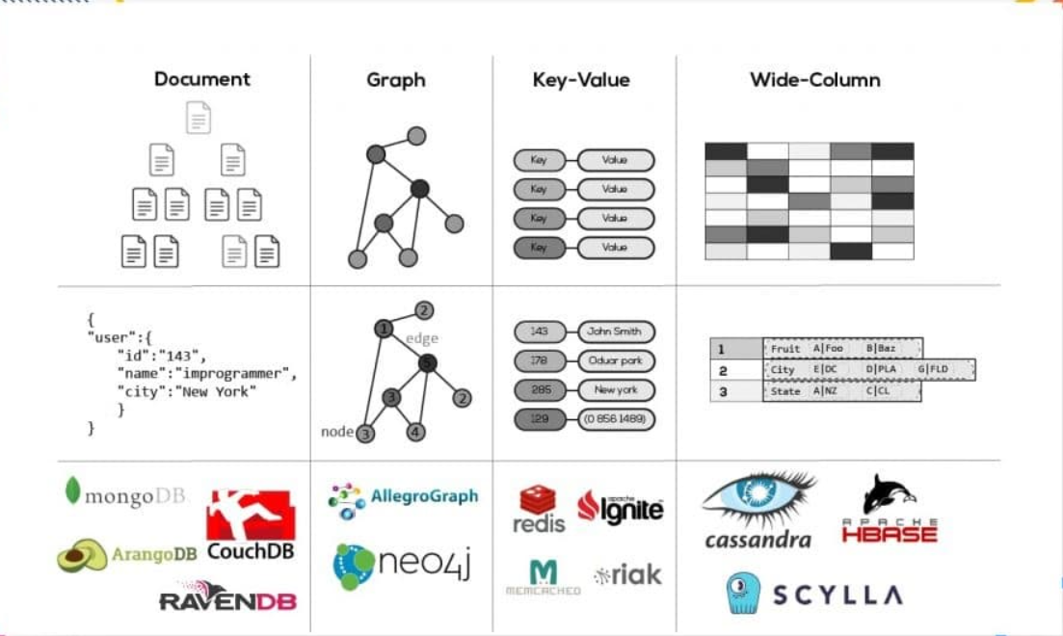
Different kinds of NOSQL databases.

Slide 4
NOSQL databases.
Document Databases – These Db usually pair each key with a complex data structure which is called a document. Documents can contain key-array pairs or key-value pairs or even nested documents. Examples of document NoSQL: MongoDB, Apache CouchDB, Raven DB, ArangoDB, Couchbase, Cosmos DB, IBM Domino, MarkLogic, OrientDB.
Key-value stores – Every single item is stored as a Key-value pair. Key-value stores are the most simple database among all NoSQL Databases. Examples of Key-value NoSQL – Redis, Memcached, Apache Ignite, Riak.
Wide-column stores – These types of Databases are optimized for queries over large datasets, and instead of rows, they store columns of data together. Examples of Wide column NoSQL – Cassandra, Hbase, Scylla.
Graph stores – These store information about graphs, networks, such as social connections, road maps, transport links. Examples of Graph NoSQL – Neo4j, AllegroGraph.

Slide 5
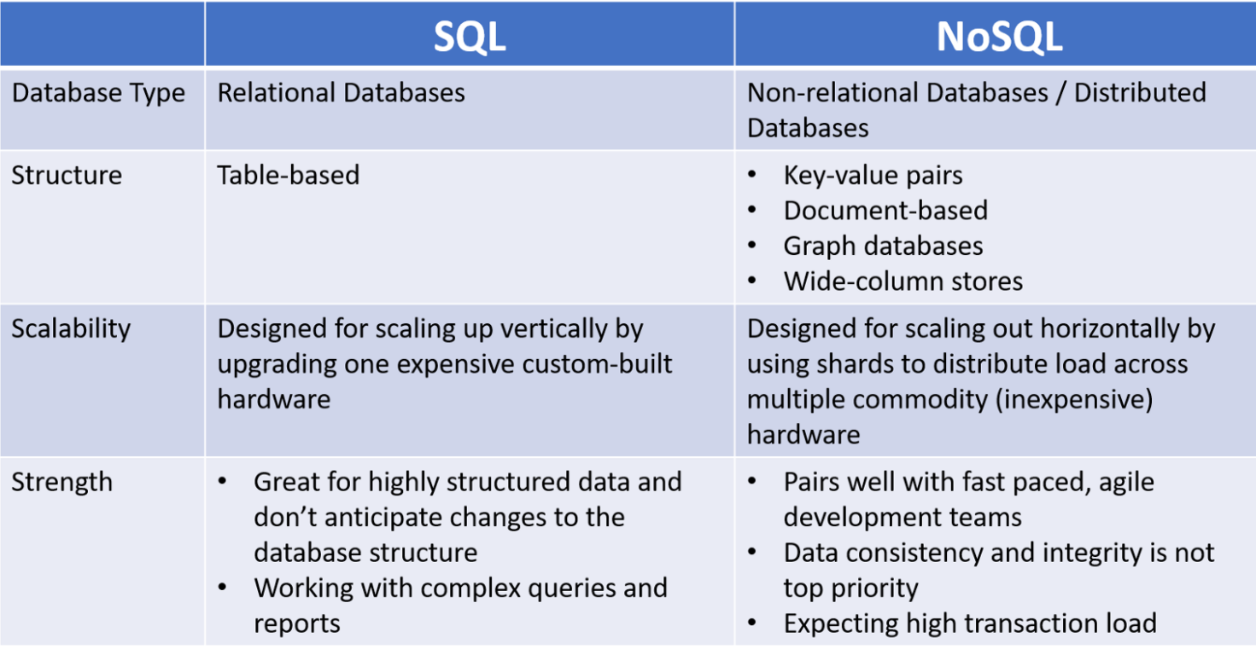
SQL vs NoSQL

Slide 6
Installing and configuring MongoDB
Download mongo db from the below given link and can be installed.
https://www.mongodb.com/try/download/community?tck=docs_server
Install Mongo Shell from the below given URL:
https://www.mongodb.com/try/download/shell

Slide 7
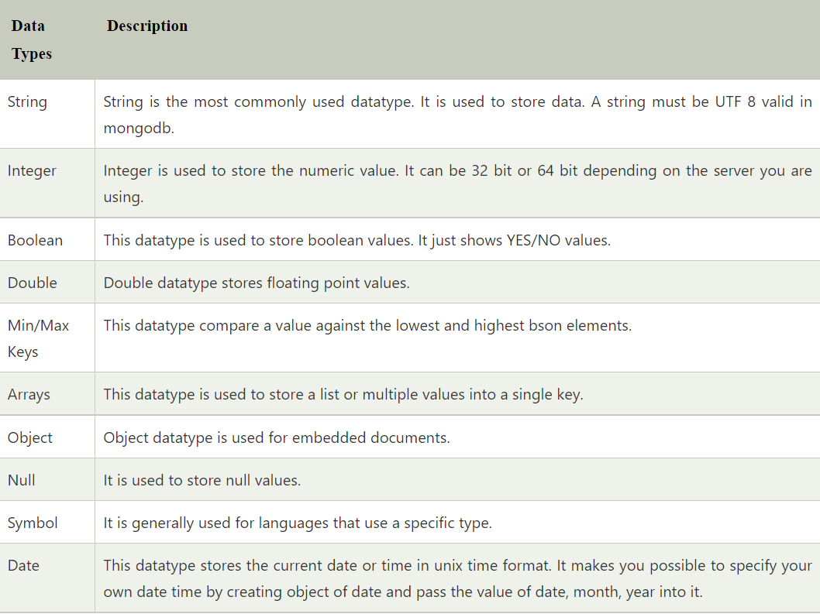
Mongo DB Data types

Slide 8
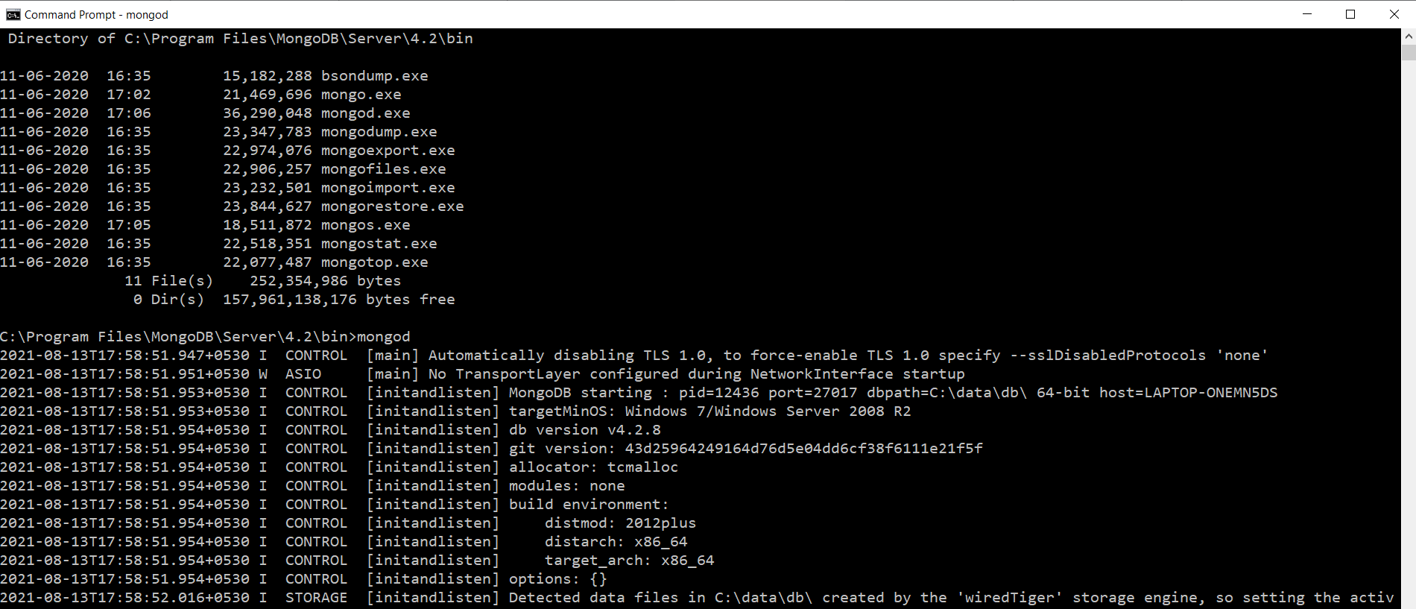
Start MondoDB Server
From the command prompt give mongod. This is Mongo DB Server.

Slide 9
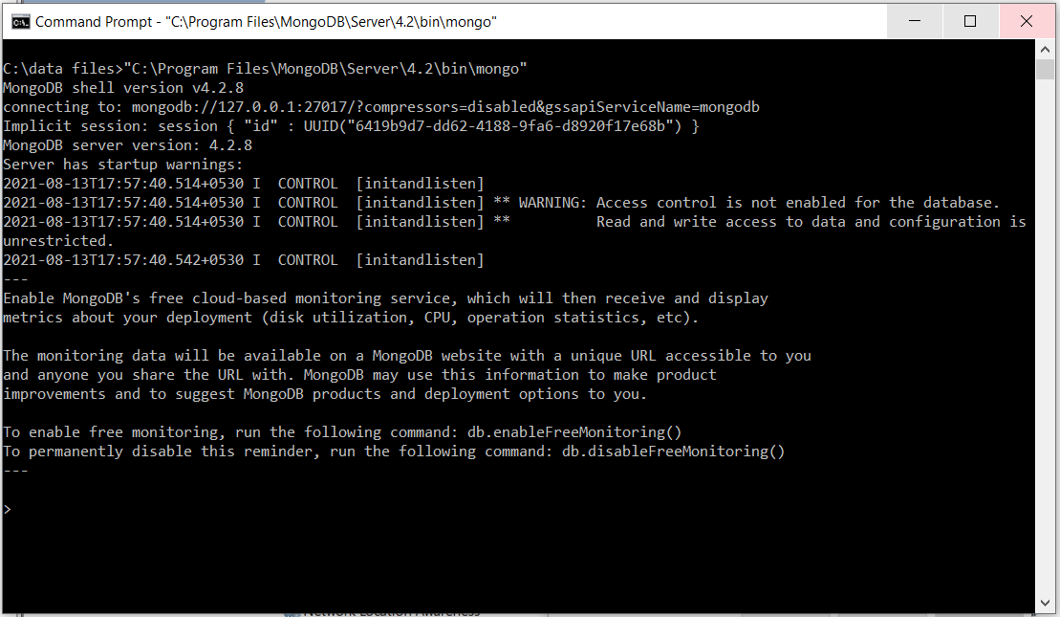
Start mongo client or Mongo Shell.
Go to any directory where data needs to be maintained and give mongo.exe as shown in the screen below:

Slide 10
Create a database
Use <database>
If the database exists then this command opesn the existing database and uses it. If the given database does not exist then it creates the database given in <database> and opens it and uses it.
“db” command in shell will show which database mongo db is using right now.
“show dbs” command will display all the databases. Immediately after creating the database, it is now shown as it does not contain any Table/collections. You can create a collection / table by using “insert” command.
Db.movie.insert ({“name:”Vikings”})

Slide 11
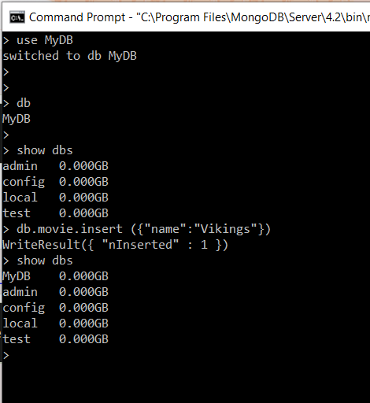
Use database and db command

Slide 12
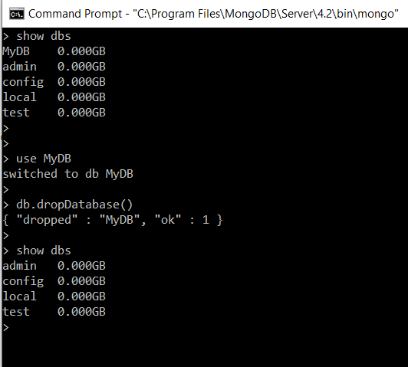
Drop a database.
Db.dropDatabase() will drop the currently selected database.

Slide 13
Create a collection.
Collection in mongodb is equivalent to table name in SQL. There are two ways to crate a collection
(1) db.createCollection (<name of collection>)
(2) Write directly into the collection, if the collection does not exist then it will create the collection and then will write into it. By using the command db.<collection name>.insert ({“attribute name”: Value, “attribute name”:value}).
Collection is Table in SQL and document is a record in SQL.
“db.collection_name.find()” will displays all the documents in the collection or in SQL → will display all the records of the table.

Slide 14
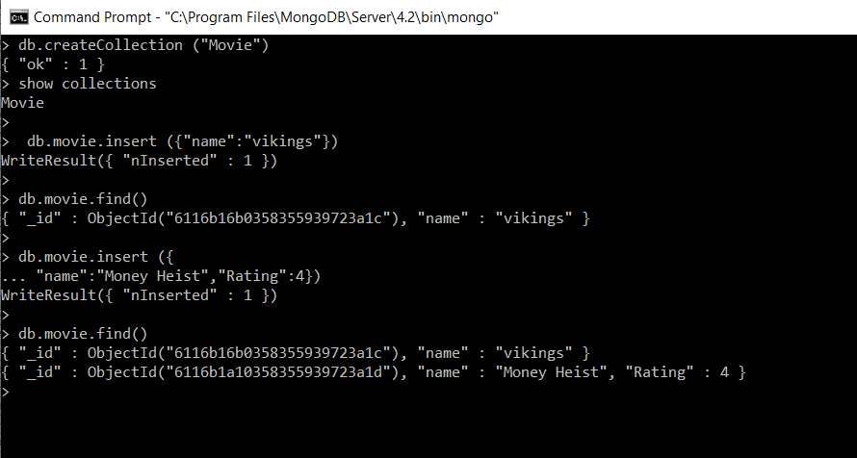
Create collection and inserting data into it.

Slide 15
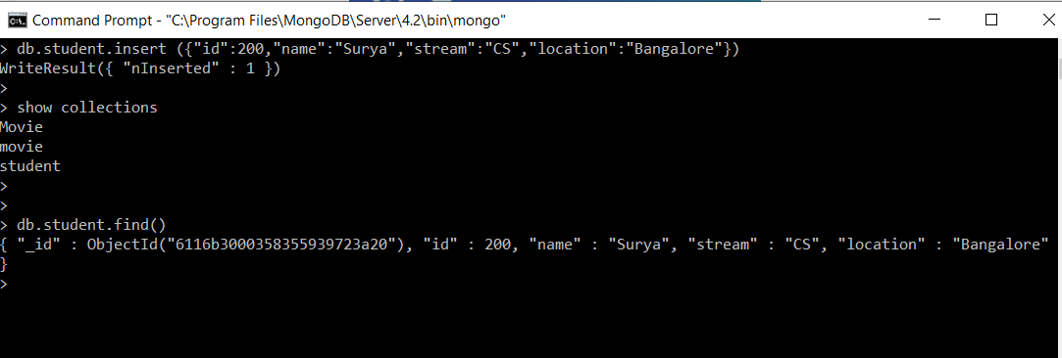
Creating collection using insert command.

Slide 16
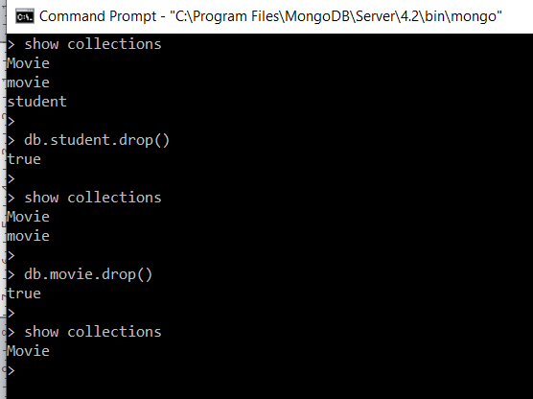
Drop the collection.
Collection / Table name in sql can be dropped by the command.
db.<collection name>.drop()

Slide 17
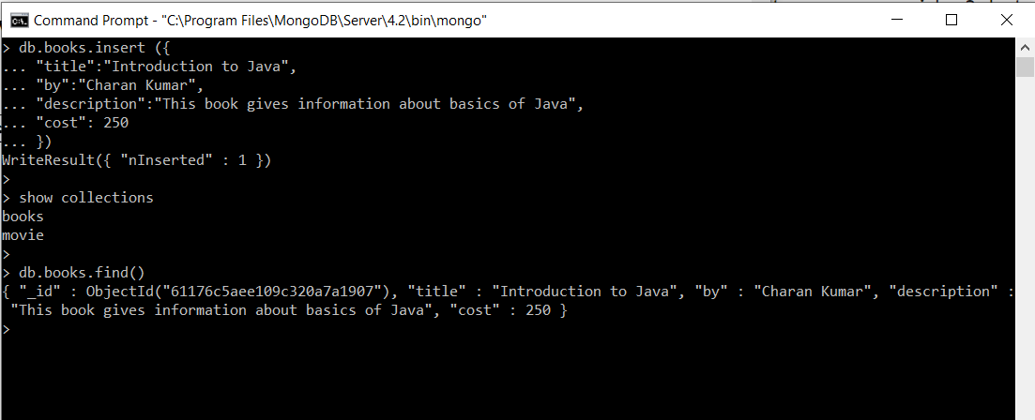
Insert a document
Document is a Record in SQL. Db.<collection Name>.insert will insert a document into a collection as show in the image below:
Db.books.insert() will add a document into a collection. Db.books.find() will display all the documents in the collection.
Writing the documents in a notepad and copy paste in the shell is a better option.

Slide 18
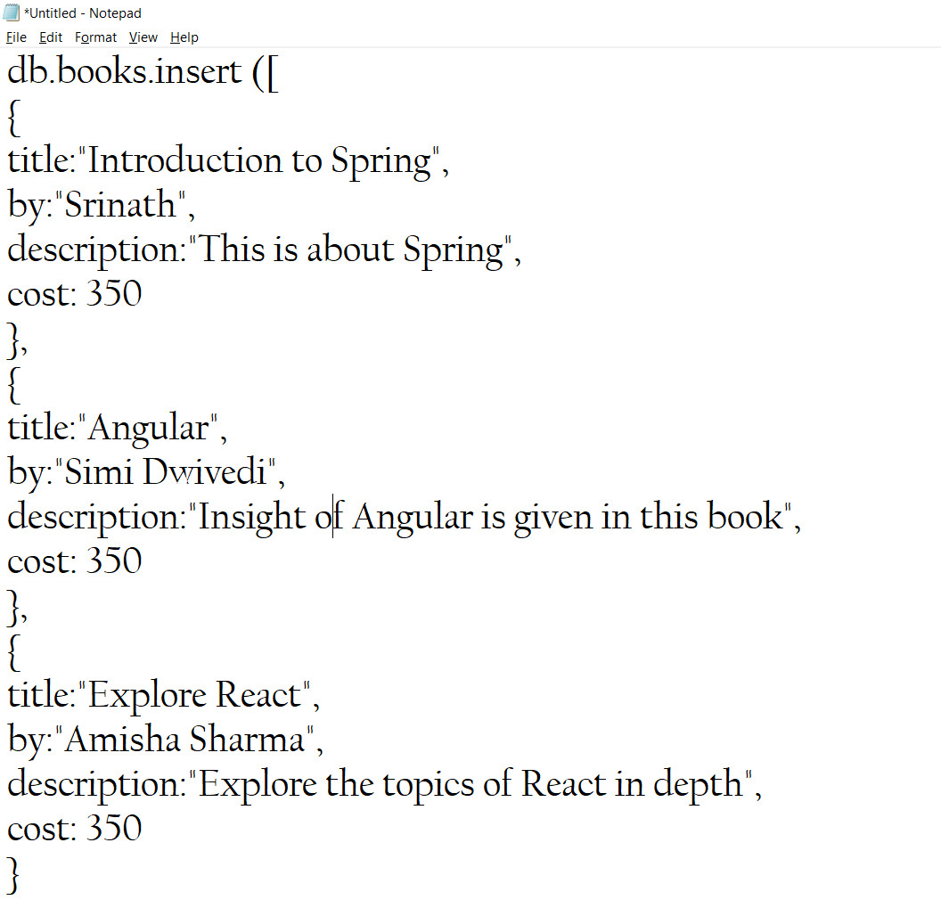
Inserting multiple documents in a collection.

Slide 19
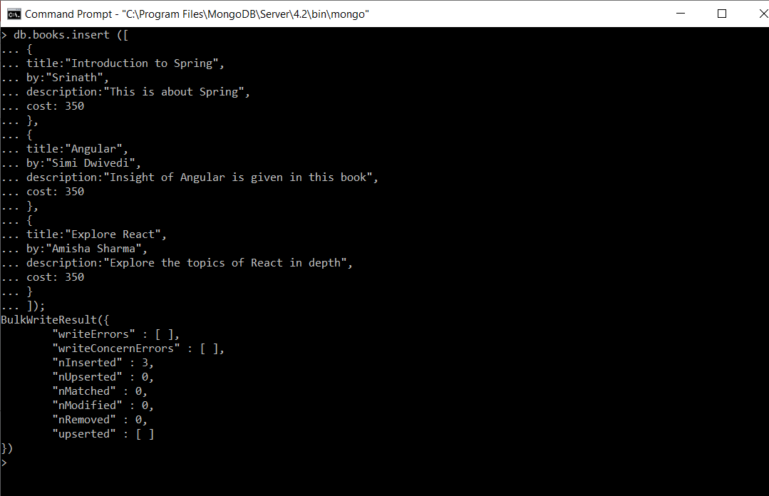
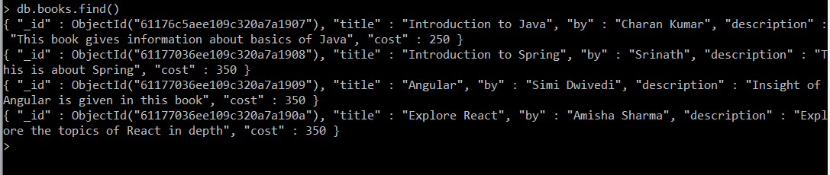

Slide 20
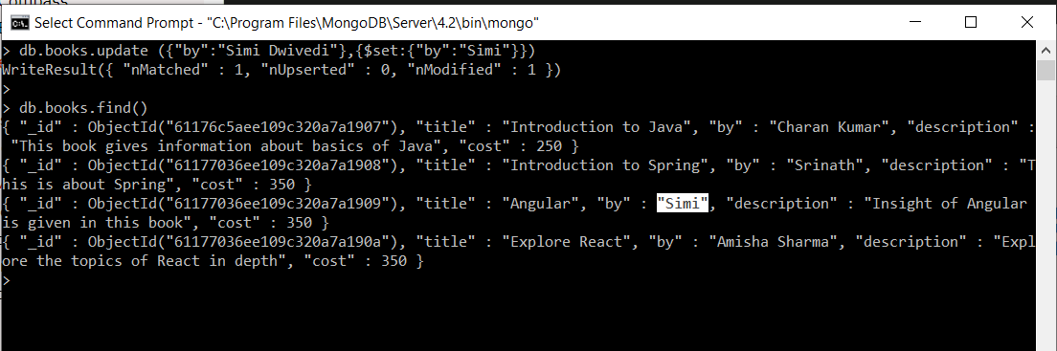
Document update.
A document can be updated using db.<collection name>.update() command.
Using db.books.update() Author Simi Dwivedi is modified to Simi.

Slide 21
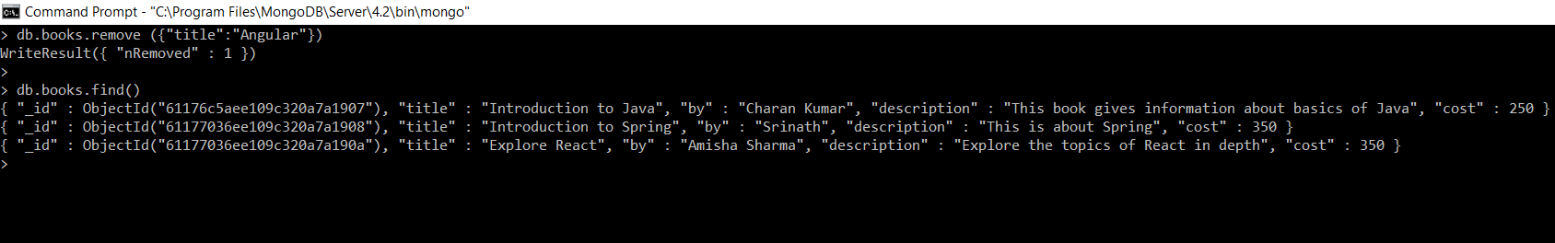
Removing a document
Db.<collection name>.remove() is used to remove or delete documents from the collection. A criteria can be specified.
Here the document titled Angular is removed.

Slide 22
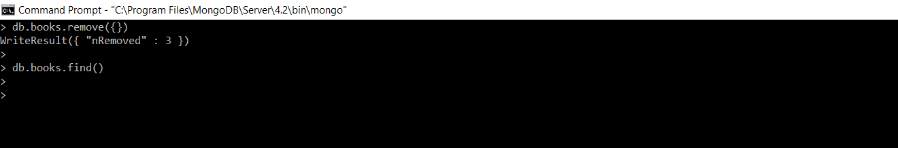
Removing all the documents.
Db.<Collection name>.remove{{}) will remove all the documents from the collection.

Slide 23
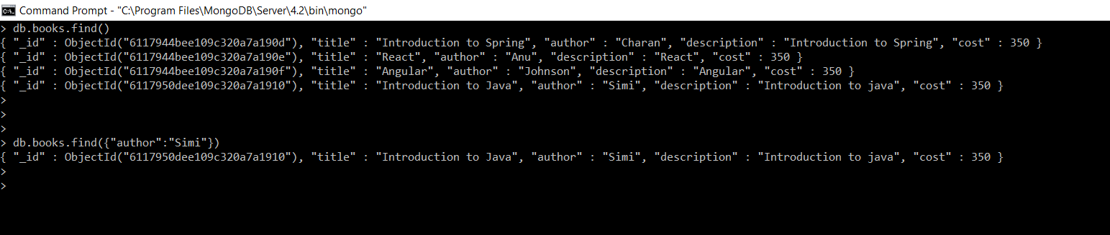
Querying documents.
Db.collection name.find() → Will retrieve all the documents.
Db.collection name.find (<condition>) → Will retrieve all the documents based on the given condition.

Slide 24
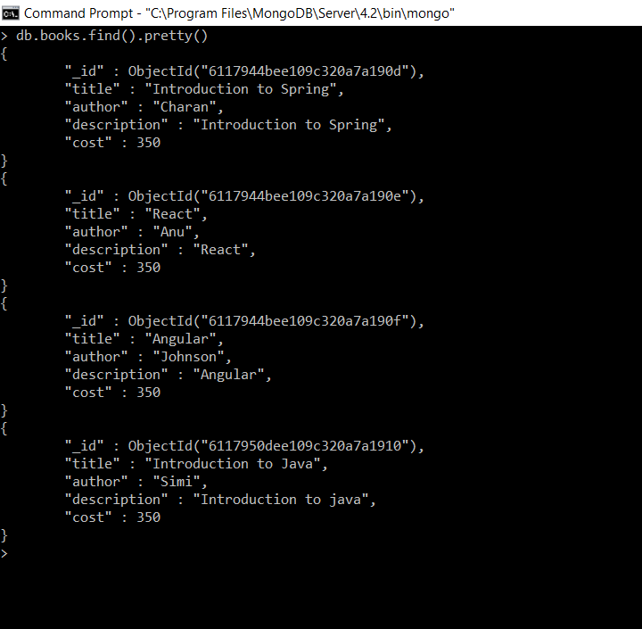
Querying and displaying using pretty()
Db.<collection name>.find().pretty() will display the data/documents in a pretty manner.

Slide 25
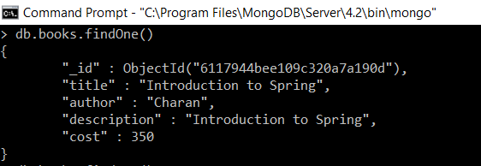
FindOne()
db.collection name.findOne() → will display the first record.

Slide 26
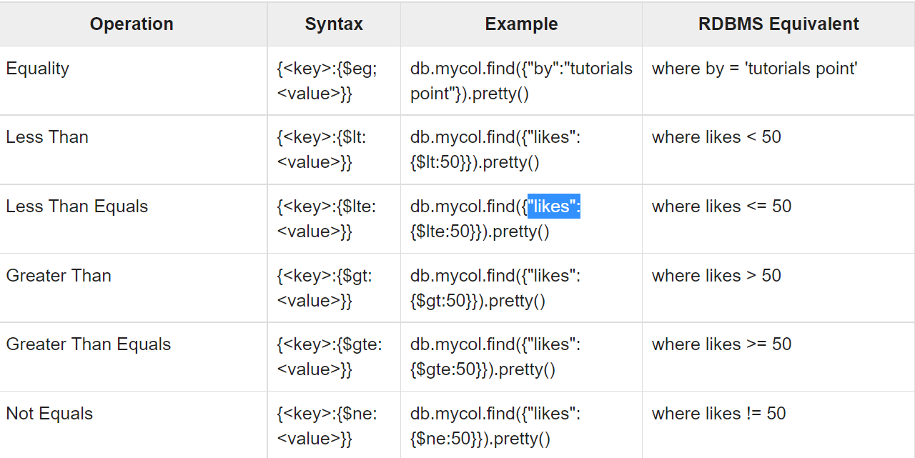
Adding conditions in find()

Slide 27
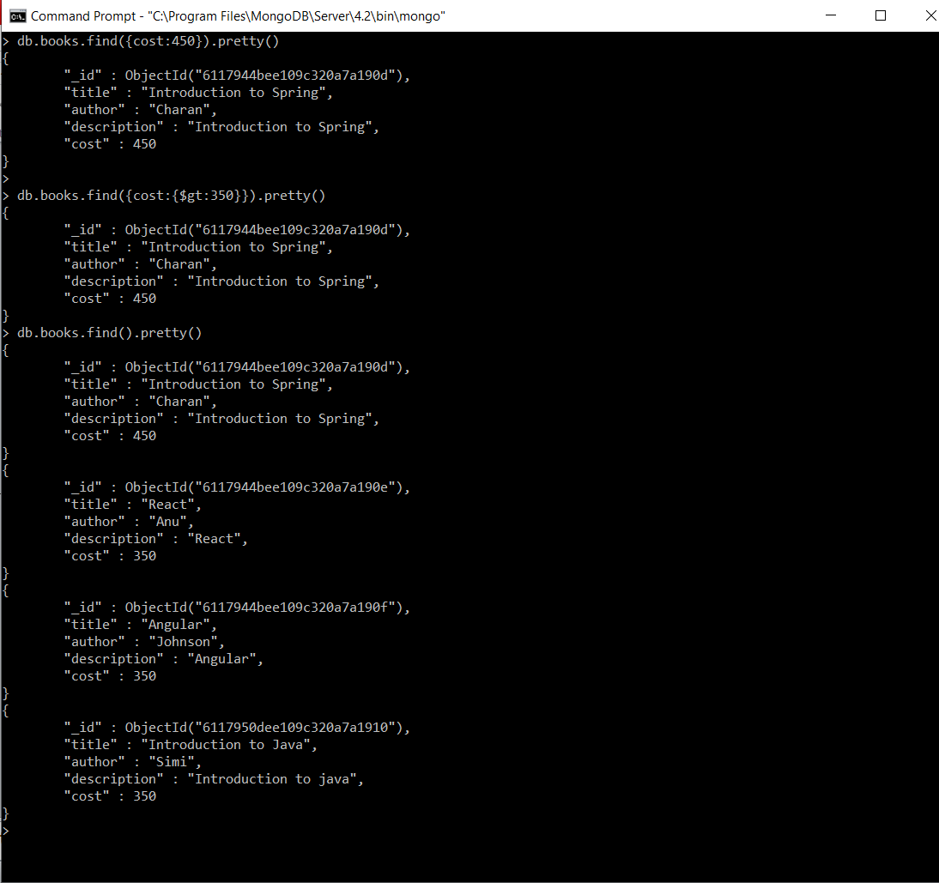
Using conditions in find().

Slide 28
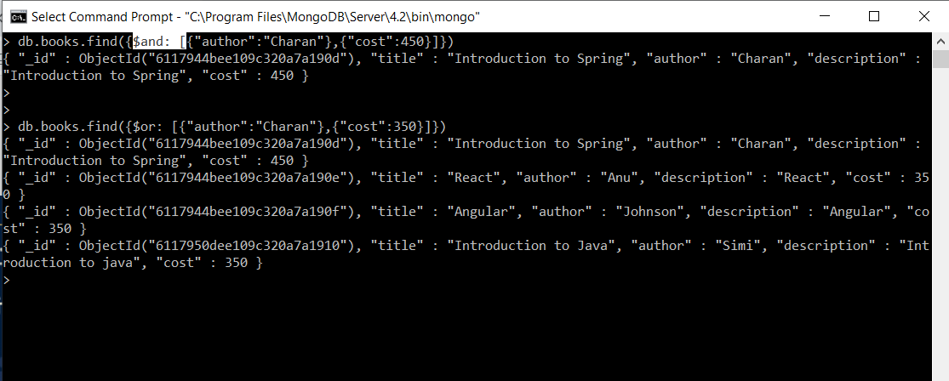
Adding and an or to find().
Db.collection name.find({$and [{attrbute:value}, {attribute:value}]}) → Gets the document anding two conditions and displays the result. The same is with or. For or $or is to be used.
First condition, author should be charan and cost should be 450.
Second condition, with or, author is charan and cost is 350. Results are displayed based on the given condition.

Slide 29
Projection.
Projection is displaying the fields we want and not displaying the fields which we do not want.
Db.colleciton name.find({},{key:0/1}) → when the key is set to 1 that field is displayed else it will not be displayed.

Slide 30
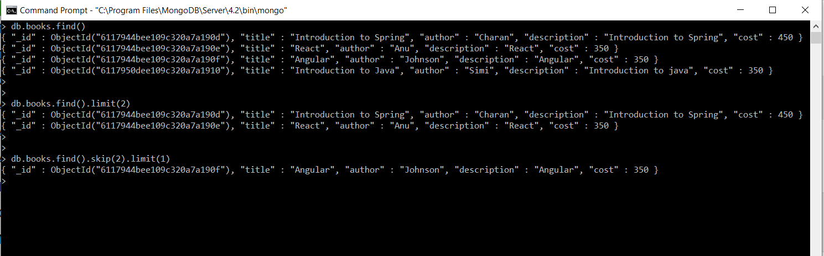
Limit() and Skip() in find().
Limit(n) will display first n records from the collection.
Skip(n) will skip n records from the beginning.
Syntax : db.collection name.find().limit (n) or db.collection name.find().skip(2).limit(1)

Slide 31
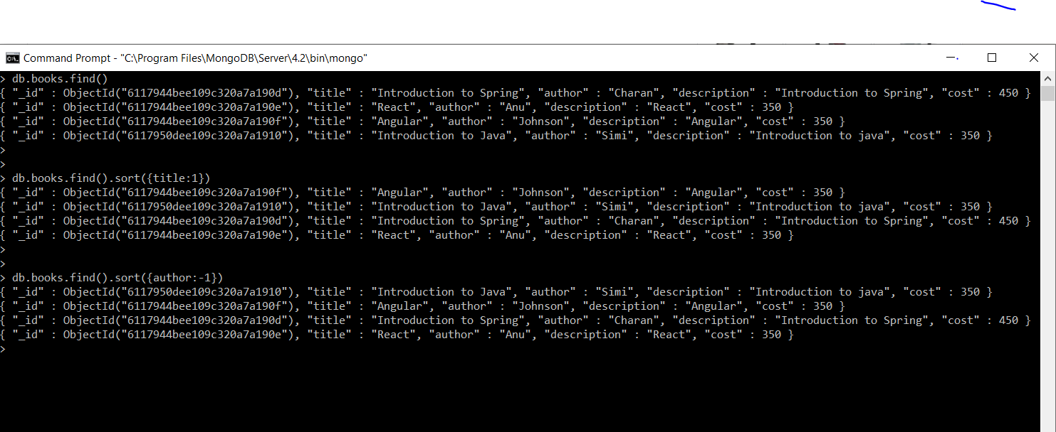
Sorting the data.
Sort() is used to sort the data displayed from collection.
Syntax is sort ({key/field name:1/-1}) → 1 sorts the field in ascending order and -1 sorts in descending order.
Db.books.find().sort ({title:1}) → Displays all the records after sorting field title in the ascending order and next command author sorts in descending order.

Slide 32
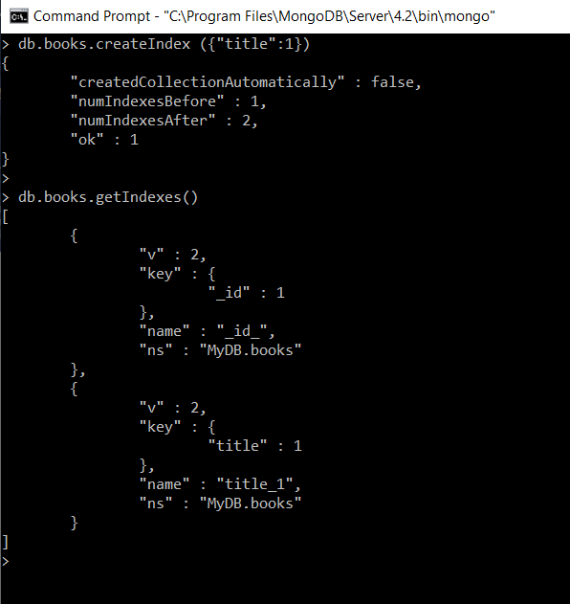
Indexing.
Indexing on a particular field will improve performance while retrieving data on that particular field.
Indexing in MongoDB can be created using db.collection name.createInde({field name:1/-1}) → 1 will index the field/key in ascending order, -1 will index the field in descending order.
Db.collection name.getIndexes() → will display all the available indexes of the collection.

Slide 33
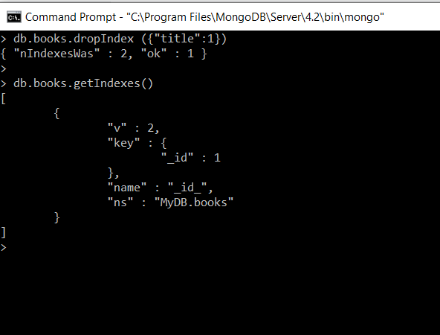
Remove the Index.
dropIndex() is used to remove the Index.
Syntax is : db.collection name.dropIndex {(Key:1/-1}).

Slide 34
Aggregate Functions
Some of aggregate functions are Min, Max, Avg, Sum.
Syntax is :
db.books.aggregate([{$group: {_id:null, MinimumCost:{$min:"$cost"}}}])
It groups by Id, since it is null all the records are considered individually. MinimumCost is the string to be displayed after performing aggregating function. $min/$max/$avg/$sum can be used as aggregate functions. And the next is the field or key on which aggregate functions to be operated upon.

Slide 35
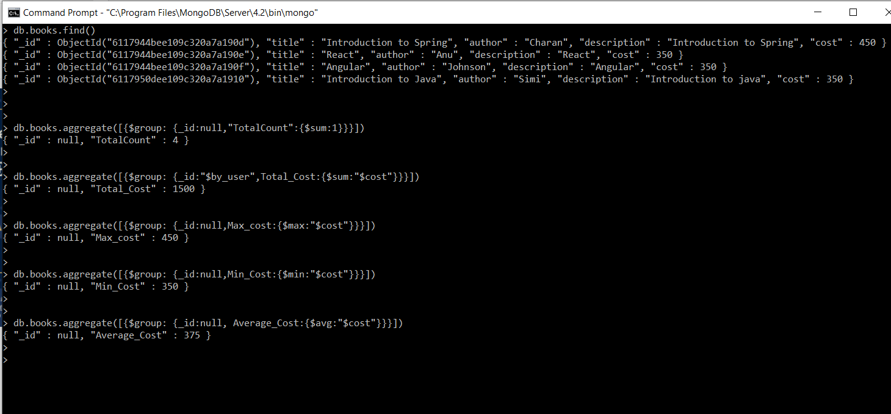
Aggregate functions

Slide 36
Thank you!

